Slide 1
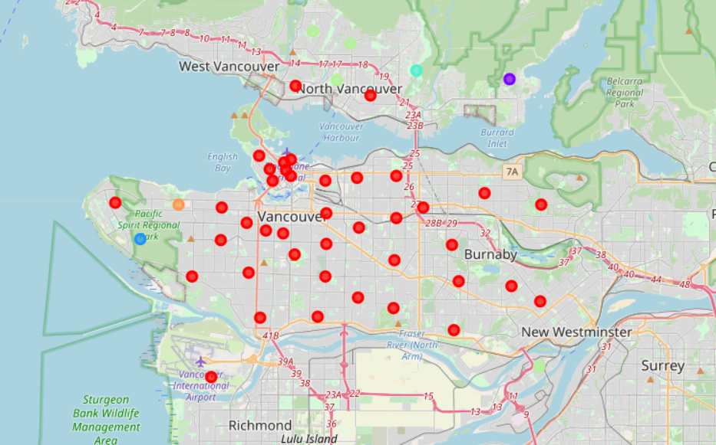
The Battle of Neighborhoods - Vancouver
The Battle of Neighborhoods - Vancouver
Applied Data Science Capstone by IBM on Coursera

Slide 2
INTRODUCTION: BUSINESS PROBLEM
The Battle of Neighborhoods - Vancouver
The purpose of this project is to use machine learning techniques to explore neighborhoods of Vancouver Canada in order to propose a potential recommendation for the location of a new restaurant or a business office.
The major stakeholders for this project are small business owners and planning to start their business at in Vancouver. This project would help them find the optimal location based on the category of their business such as:
What’s a best spot to open up a restaurant in Vancouver?
What type of restaurant is most likely to be successful in different parts of the city?

Slide 3
INTRODUCTION: BUSINESS PROBLEM
The Battle of Neighborhoods - Vancouver
The Foursquare API is used to access the venues in the neighborhoods. Since, it returns less venues in the neighborhoods, we would be analyzing areas for which countable number of venues are obtained.
Then they are clustered based on their venues using Data Science Techniques. Here the k-means clustering algorithm is used to achieve the task.
Folium visualization library can be used to visualize the clusters superimposed on the map of Vancouver city. These clusters can be analyzed to help small scale business owners select a suitable location for their need such as Hotels, Shopping Malls, Restaurants or even specifically Indian restaurants or Coffee shops.

Slide 4
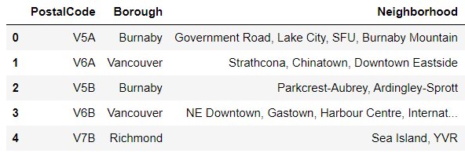
DATA REQUIREMENTS
The Battle of Neighborhoods - Vancouver
Vancouver has many neighborhoods. The Wikipedia website has the list of all postal codes starting with V. Only postal codes in and around Vancouver are selected amongst this data
"https://en.wikipedia.org/wiki/List_of_postal_codes_of_Canada:_V"

Slide 5
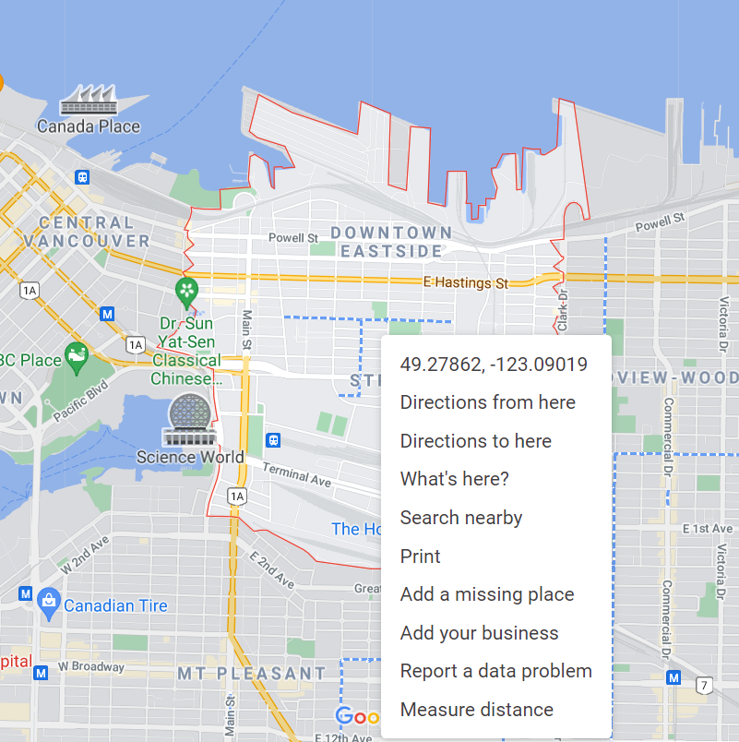
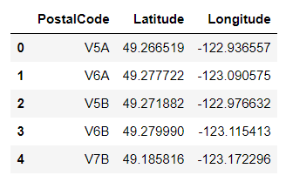
DATA REQUIREMENTS
The Battle of Neighborhoods - Vancouver
Unfortunately, the latitude and longitude values are missing for these postal codes in the website and geocode python module is very inaccurate. Therefore the latitude and longitude data has been procured from the google maps website manually and finally everything merged together.

Slide 6
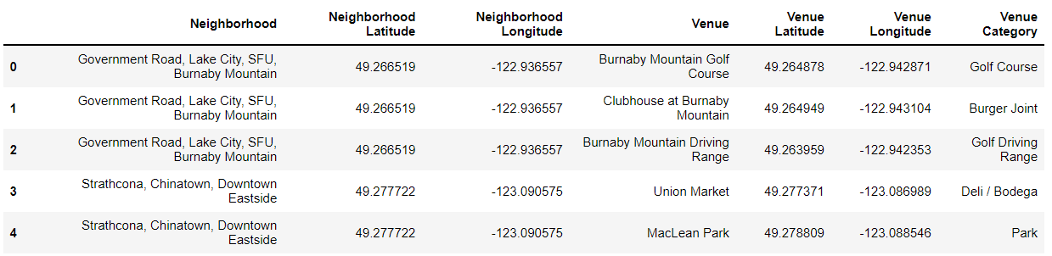
DATA REQUIREMENTS
The Battle of Neighborhoods - Vancouver
Next, the venues information data for each neighborhood is extracted from the foursquare data as follows using the latitude and longitude:
https://foursquare.com/

Slide 7
METHODOLOGY
The Battle of Neighborhoods - Vancouver
Now, we have the neighborhoods data of Vancouver (46 neighborhoods). We also have the most popular venues in each neighborhood obtained using Foursquare API. A total of 943 venues have been obtained in the whole city and 209 unique categories.
Here, the K-Nearest Neighbor (KNN) clustering algorithm is used. It is an unsupervised machine learning technique that clusters the given data into K number of clusters. For optimal result we need to select the best value for K. Here, the silhouette score is used to find the best value for K. A range of values from 2 to 10 was considered, KNN clustering was performed on the dataset and the value of 6 provides the best score. This K value is used for the K-Means Clustering Technique.

Slide 8
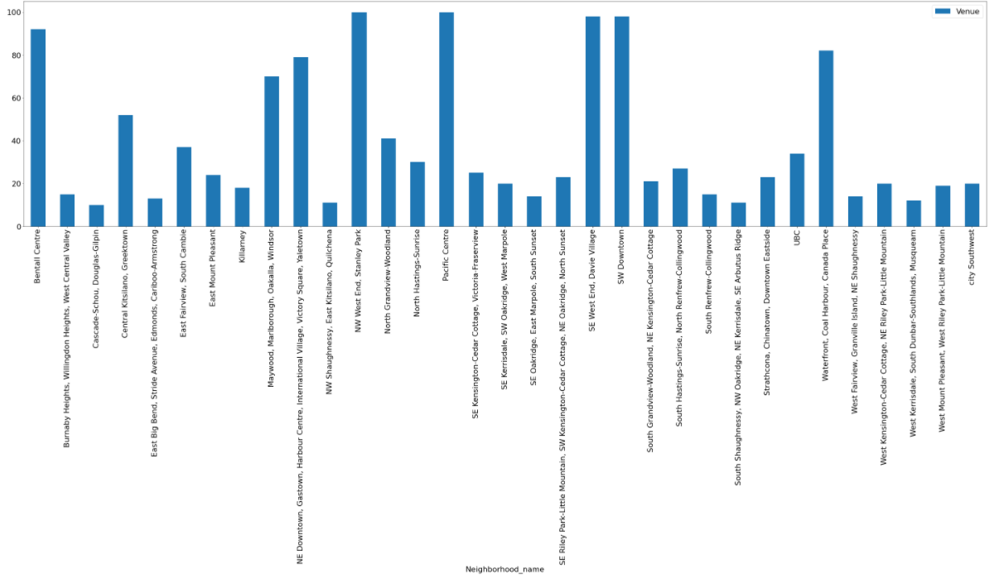
ANALYSIS
The Battle of Neighborhoods - Vancouver
Looking into the dataset we found that there were many neighborhoods with less than 10 venues which can be remove before performing the analysis to obtain better results. The following plot shows only the neighborhoods from which 10 or more than 10 venues were obtained.

Slide 9
ANALYSIS
The Battle of Neighborhoods - Vancouver
One hot encoding is performed on the filtered data to obtain the venue categories in each neighborhood. Then group the data by neighborhood and take the mean value of the frequency of occurrence of each category.
This is used to obtain the top 10 most common venues in each neighborhood i.e. the 10 venues with the highest mean of frequency of occurrence.
The resultant dataset can be used for the clustering algorithm. Here, the K-Nearest Neighbor (KNN) clustering algorithm is used. It is an unsupervised machine learning technique that clusters the given data into K number of clusters.
For optimal result we need to select the best value for K. Here, the
silhouette score is used to find the best value for K.

Slide 10
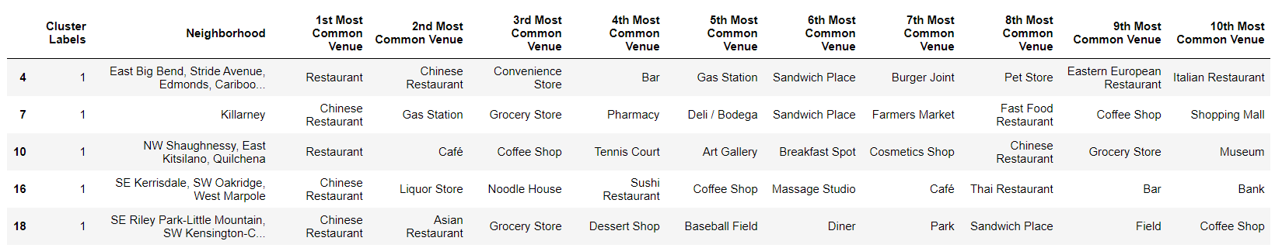
RESULTS AND DISCUSSION
The Battle of Neighborhoods - Vancouver
Clusters 1:
Clusters 2:

Slide 11
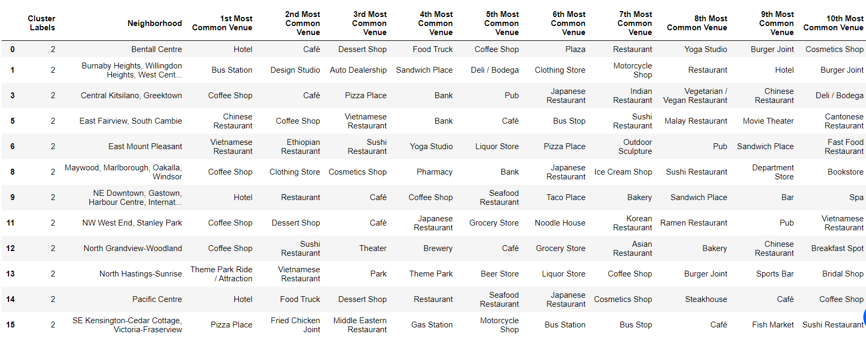
RESULTS AND DISCUSSION
The Battle of Neighborhoods - Vancouver
Clusters 3:

Slide 12
RESULTS AND DISCUSSION
The Battle of Neighborhoods - Vancouver
Clusters 4:
Clusters 5:
Clusters 6:

Slide 13
RESULTS AND DISCUSSION
The Battle of Neighborhoods - Vancouver
Restaurant
Clusters 1,2,3 and 5 has large number of Asian restaurants, so we recommend to the business owner if they’re moving into these areas, they shouldn’t think of any new Asian restaurants but to think about a new venue; it could be middle eastern or Mexican food as the prevalence of these type of restaurants are low.
Also they can be moving into cluster areas of 4 and 6 where the density of restaurants are very low and they can start thinking about starting a new Asian restaurant with less competition.

Slide 14
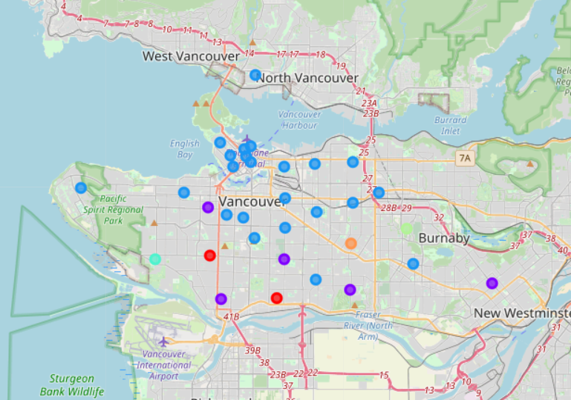
RESULTS AND DISCUSSION
The Battle of Neighborhoods - Vancouver
Restaurant

Slide 15
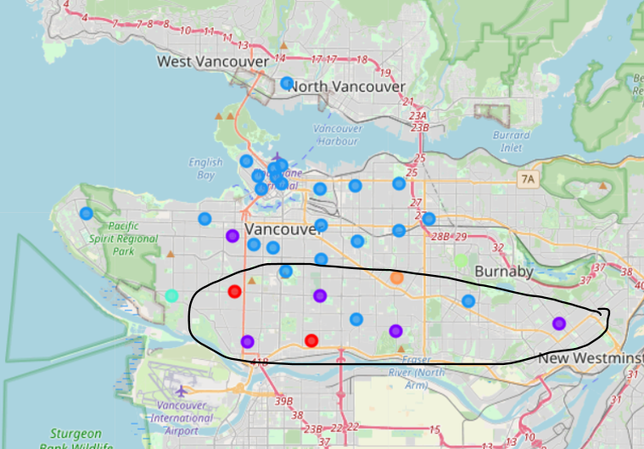
RESULTS AND DISCUSSION
The Battle of Neighborhoods - Vancouver
Hotel
The neighborhoods in cluster 3 has the greatest number of hotels, hence opening one here is not the best choice. The optimal place would be one which has less hotels, but also have restaurants and other places to explore.

Slide 16
DRAWBACKS
The Battle of Neighborhoods - Vancouver
A major limitation of this project was that the Foursquare API returned only few venues in each neighborhood.
As a future improvement, better data sources can be used to obtain more venues in each neighborhood.
This way the neighborhoods that were filtered out can be included in the clustering analysis to create a better decision model using KNN clustering algorithm.

Slide 17
CONCLUSION
The Battle of Neighborhoods - Vancouver
Purpose of this project was to analyze the neighborhoods of Vancouver and create a clustering model to suggest places to start a new business based on the category.
The neighborhoods data was obtained from an online source and the Foursquare API was used to find the major venues in each neighborhood.
The best number of clusters i.e. 6 was obtained using the silhouette score. Each cluster was examined to find the most venue categories present, that defines the characteristics for that particular cluster.
A few examples for the applications that the clusters can be used for have also been discussed. A map showing the clusters have been provided. Both these can be used by stakeholders to decide the location for the particular type of business.

